Slide 1

Today’s Contents
Image Digitization
Sampling (coordinate digitization)
Quantization (amplitude/intensity digitization)
Representation of Digital Image
Effect of Spatial and Gray Level Resolutions
Chapter 2 from R.C. Gonzalez and R.E. Woods, Digital Image Processing
(3rd Edition), Prentice Hall, 2008 [ Section 2.4, except 2.2.4 ]

Slide 2












Image Digitization
Computers use discrete form of the pictures
The process transforming continuous analog image into discrete approximated image is called digitization.
Transforming
Process
Analog image
Digital image
Two steps:
Sampling and
Quantization

Slide 3
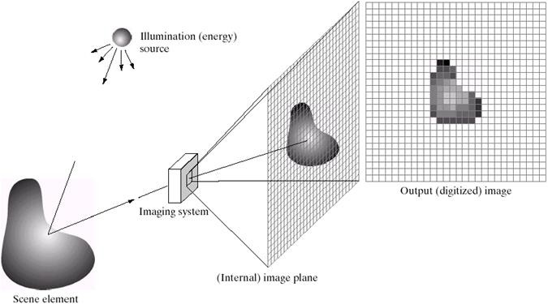
Image Digitization
Image sensor (physical device) that is sensitive to the energy radiated by the object capture the image.
Digitizer converts the output of this physical sensing device
into digital form.
A digital sensor can only measure a limited number of
samples at a discrete set of energy levels.

Slide 4
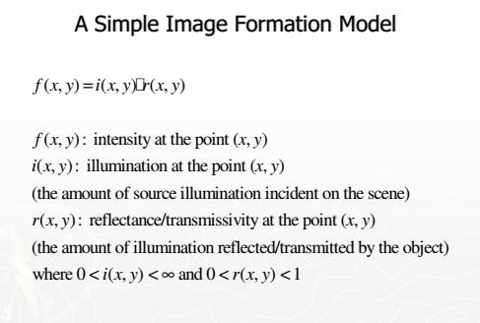

Slide 5
Image Sampling And Quantisation
Sampling:
Digitizing coordinates
A process which converts the continuous analog space into a discrete space
Quantization:
Digitizing amplitudes (gray scale values)
A process of converting a continuous analogue signal into a
digital representation of that signal

Slide 6
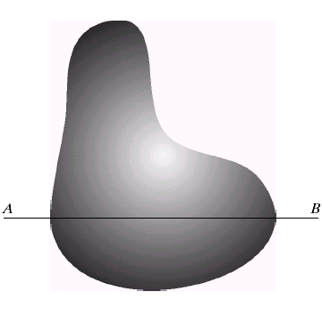
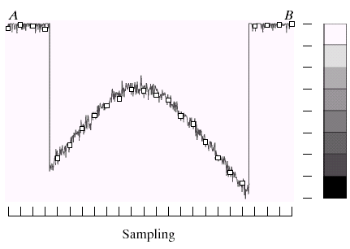
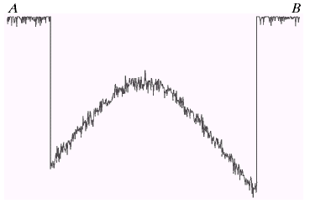
Image Sampling And Quantisation
7
6
5
4
3
2
1
0
Digitizing the amplitude values

Slide 7
Image Sampling And Quantisation
Digitizing the coordinate values

Slide 8
Image Sampling And Quantisation
7
6
5
4
3
2
1
0
A
7 | 7 | 7 | 1 | 2 | 3 | 4 | 4 | 5 | 5 | 5 | 5 | 5 | 4 | 3 | 3 | 2 | 1 | 0 | 0 | 7 | 7 | 7
B

Slide 9
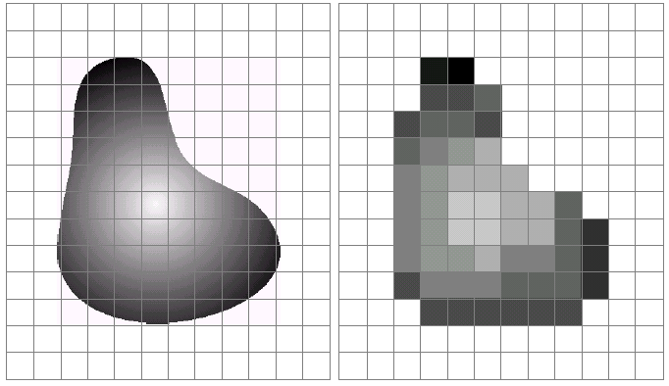
Image Sampling And Quantisation
Remember that a digital image is always only an approximation of a real world scene

Slide 10
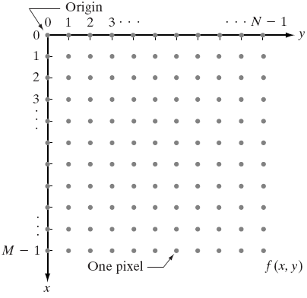
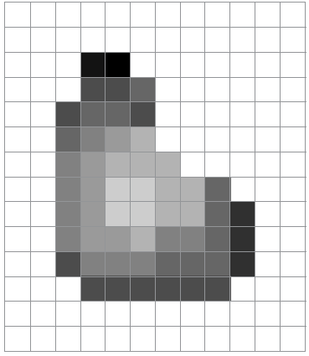
Representation of Digital Image
Matrix Representation

Slide 11
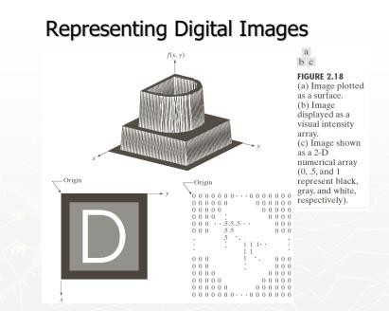

Slide 12
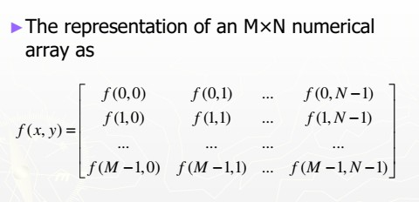
Representation of Digital Image

Slide 13
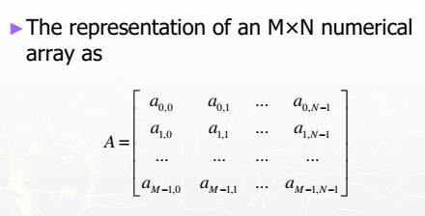
Representation of Digital Image
Traditional Matrix

Slide 14
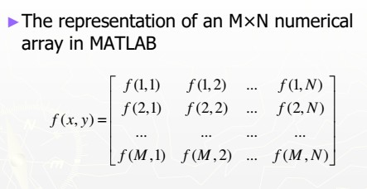
Representation of Digital Image

Slide 15
Representation of Digital Image
Formally,
Sampling:
Dividing (x, y) plane into grid with coordinate (z_{i}, z_{j}), where,
z_{i} , z _{j} ∈ Z
Quantization:
Assign gray level value from Z to f(z_{i}, z_{j})

Slide 16
Representation of Digital Image
L: Gray level resolution
Number of gray levels, L, is usually power of 2:
L = 2^{k}
Bit depth = k
Spatial resolution: M x N
Number of Rows (M) and Columns (N) can be any integer
Bit size of an image:
b = M × N × k
b = N ² k
For Square image,

Slide 17
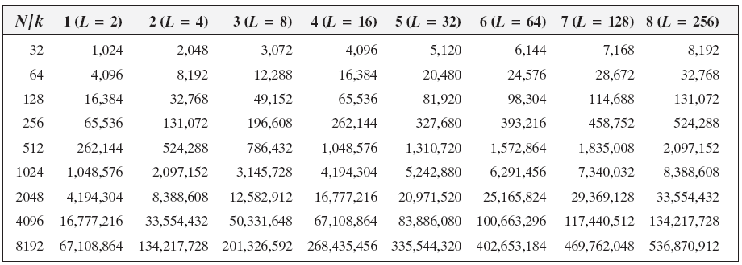
Image Sizes in bits for Different Spatial and Gray Level Resolutions
The calculation is for square images
N = number of row/column
L = gray level resolution
K= bit required to represent gray levels

Slide 18

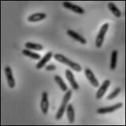
Digital Image Types : Intensity Image
Intensity image or monochrome image
each pixel corresponds to light intensity normally represented in gray scale (gray level).
Gray scale values
⎡10 10 16 28⎤
⎢ 6 26 37⎥
⎥
⎢15 25 13 22⎥
⎢32 15 87 39⎥
⎢ ₉
⎢
⎥

Slide 19

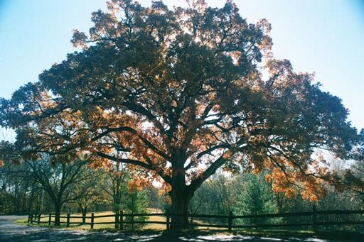

Digital Image Types : RGB Image
Color image or RGB image: each pixel contains a vector representing red, green and blue components.
RGB components
⎡10 10 16 28⎤
_{⎢ 9} ⎡65 70 56 43⎤
⎥
⎢₃₂⎡99 70 56 78⎤
90 96 67⎥
85
6 26 37⎥
5 25 13 22⎥
⎥
2 15 87 39⎥
⎢
⎥
54 96 67⎥
1 54 47 42⎥
⎥
65 65 39⎥
⎢1 ⎢ ⎢₆₀
⎢₃ ⎢2
⎢
⎥
⎢
⎢₅₄⎢85
43 92⎥
⎢
⎢32
65 87 99⎥
⎢
⎥

Slide 20


Image Types : Binary Image
Binary image or black and white image
Each pixel contains one bit : 1 represent white
0 represents black
Binary data
⎢
⎢
⎡0 ⎢₀ | 0 0 | 0 0 | 0⎤ ₀⎥ ⎥
⎢1 ⎢₁ | 1 1 | 1 1 | 1⎥ ₁⎥ ⎥

Slide 21

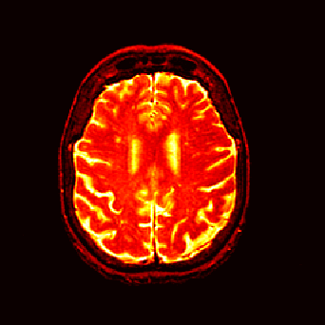
Image Types : Index Image
Index image
Each pixel contains index number pointing to a color in a color table
Color Table
Index No. | Red component | Green component | Blue component
1 | 0.1 | 0.5 | 0.3
2 | 1.0 | 0.0 | 0.0
3 | 0.0 | 1.0 | 0.0
4 | 0.5 | 0.5 | 0.5
5 | 0.2 | 0.8 | 0.9
… | … | … | …
⎡1 4 9⎤
⎢ ⁴ ⎥
⎢6 5 2⎥
⎢₆
₇⎥
Index value

Slide 22

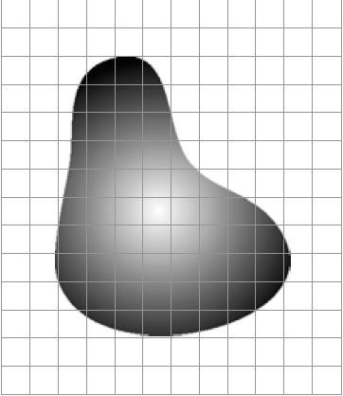
Effect of Spatial and Gray Level
Resolutions
14X12 resolution means samples from 14X12
What happens, if we sample from 8X8 locations?

Slide 23
Effect of Spatial and Gray Level Resolutions
14X12 resolution means samples from 14X12
What happens, if we sample from 8X8 locations?
Larger cell size
Lower spatial resolution
Lower features spatial accuracy
Lower file size, faster display and faster processing time

Slide 24
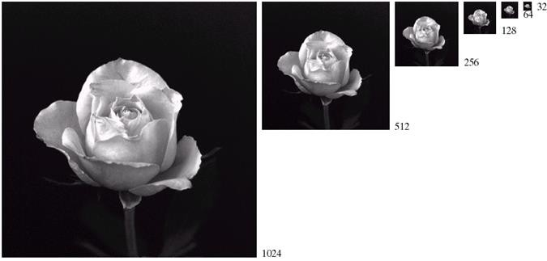
Effect of Spatial Resolutions
Sub sampled from 1024X1024 up
to 32X32
unchanged gray level (intensity)
Delete alternate row and column while
sub sampling

Slide 25
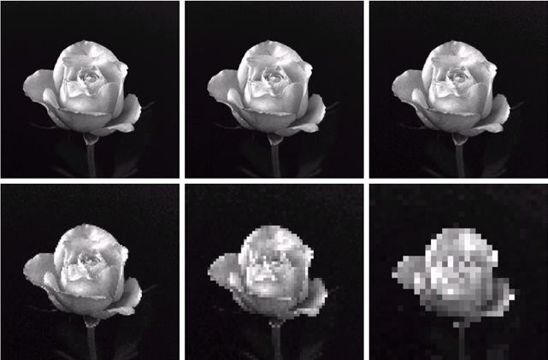
Effect of Spatial Resolutions
Resized to 1024 x 1024
From 1024X1024 512X512 256X256
Using column
duplication process
From
128X128
64X64
32X32

Slide 26
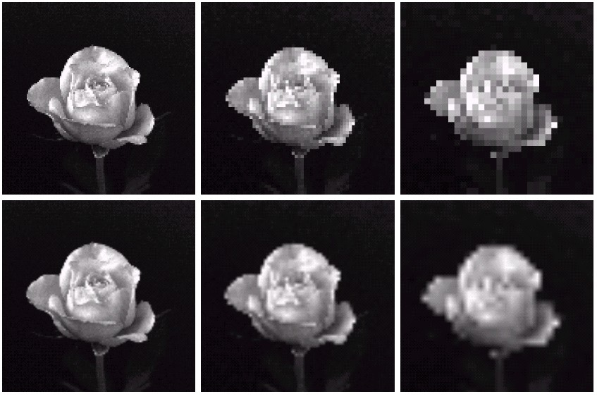
Can we increase spatial resolution ?
From 128X128
64X64
32X32
Using nearest neighbor
Using bilinear interpolation
From
128X128 64X64 32X32
Down sampling is an irreversible process.

Slide 27

Intensity (Gray) Level Resolution
Intensity level resolution refers to the number of intensity levels used to represent the image
The more intensity levels used, the finer the level of detail discernable in an image
Intensity level resolution is usually given in terms of the number of bits used to store each intensity level
Number of Bits | Number of Intensity Levels | Examples
1 | 2 | 0, 1
2 | 4 | 00, 01, 10, 11
4 | 16 | 0000, 0101, 1111
8 | 256 | 00110011, 01010101
16 | 65,536 | 1010101010101010

Slide 28
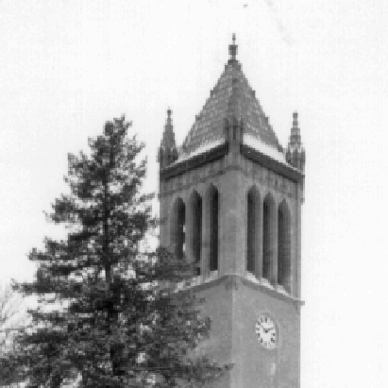


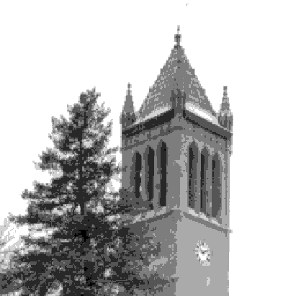
Effect of Gray level Resolutions
unchanged spatial resolution
Gray level changed from 256 to 32
256 levels
128 levels
64 levels
32 levels

Slide 29

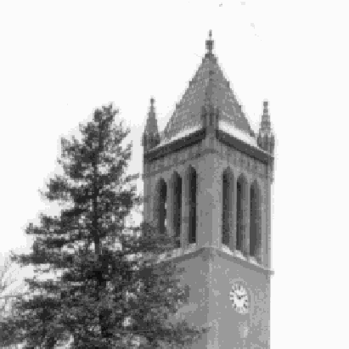
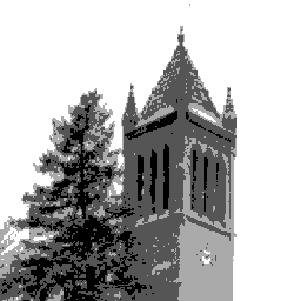

Effect of Gray level Resolutions
Gray level changed from 16 to 2
16 levels
8 levels
In this image, it is easy to see false contour.
4 levels
2 levels

Slide 30
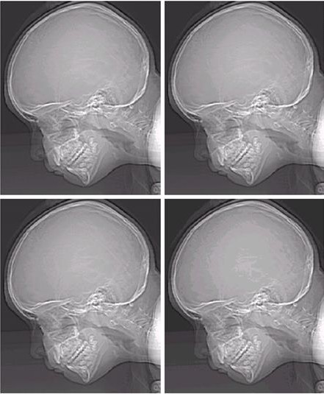
Effect of Gray level Resolutions
unchanged spatial resolution
Gray level changed from 256 to 32
Ridge-like structure in the smooth area

Slide 31
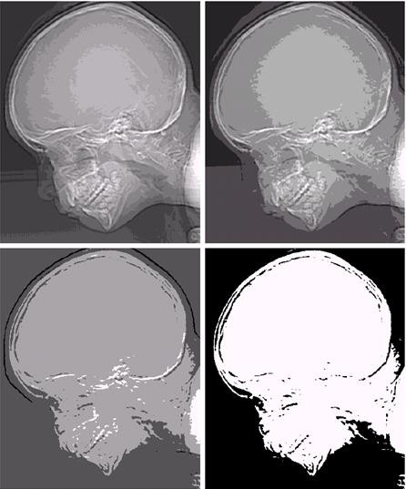
Effect of Spatial and Gray Level Resolutions
Gray level changed from 16 to 2
Ridge-like structure is more prominent
Reason: insufficient number of gray levels used

Slide 32
Resolution: How Much Is Enough?
The big question with resolution is always how much is enough?
This all depends on what is in the image and what you would like to do with it
Key questions include
Does the image look aesthetically pleasing?
Can you see what you need to see within the image?

Slide 33
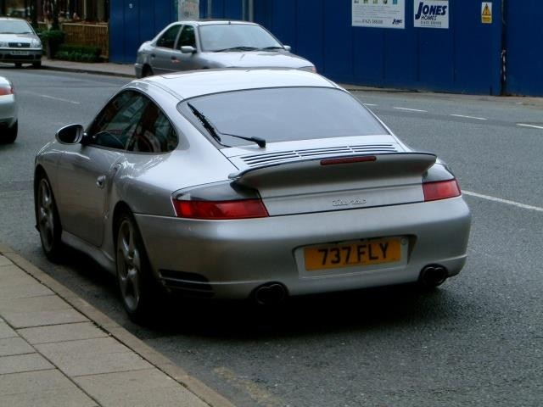

Resolution: How Much Is Enough? (cont…)
The picture on the right is fine for counting the number of cars, but not for reading the number
plate

Slide 34
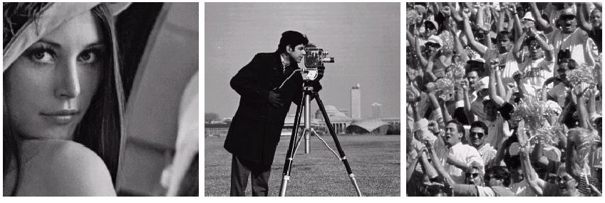
How to select the suitable size and pixel depth of images
The word “suitable” is subjective: depending on “subject”.
Low detail image
Lena image
Medium detail image
Cameraman image
High detail image
To satisfy human mind
For images of the same size, the low detail image may need more pixel depth.
As an image size increase, fewer gray levels may be needed.

Slide 35

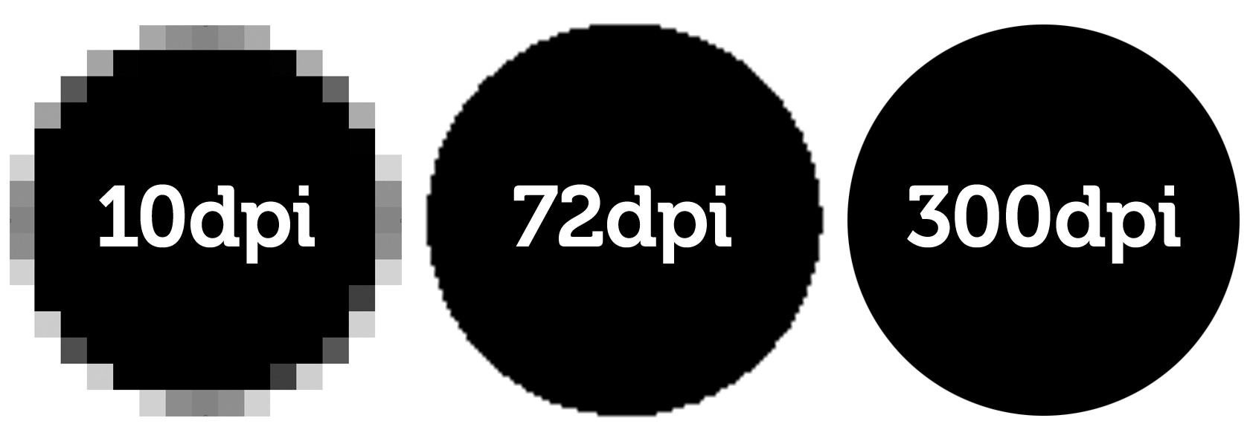
Resolution
is a display parameter, defined in dots per inch (DPI) or equivalent measures of spatial pixel density, and its standard value for recent screen technologies is 72 dpi. Recent printer resolutions are in 300 dpi and/or 600 dpi.

